Slide 1
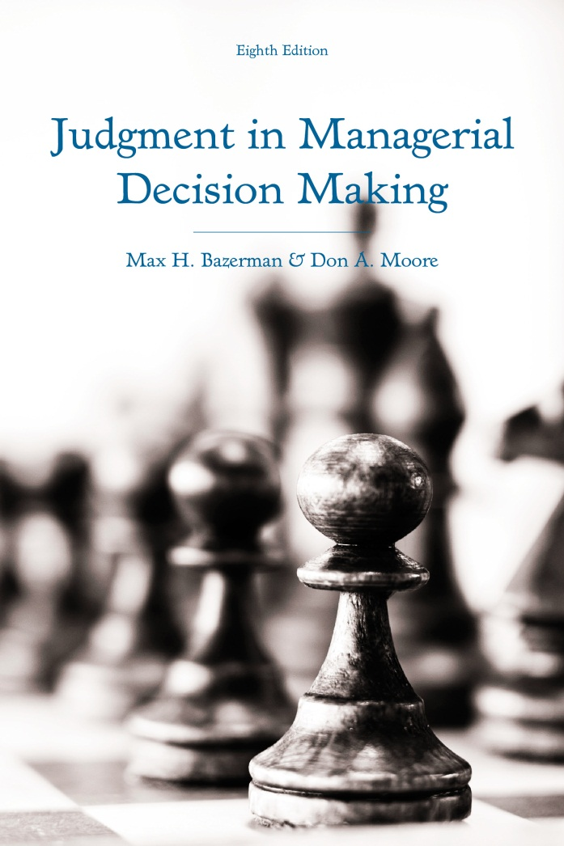
Judgment in Managerial Decision Making 8e
Chapter 7
The Escalation of Commitment
Copyright 2013 John Wiley & Sons
Notes:
As noted previously, we tend to use heuristics, or rules of thumb, to reduce the complexity of our decisions.
Often, these heuristics allow us to make effective decisions in a short amount of time.
However, under the right set of circumstances they can also lead us into making biased decisions.
Avoiding the biases that come with the use of heuristics is so difficult that even the most intelligent people are prone to error.
Before introducing key biases, take a few minutes to answer the following questions. Write down your answers.

Slide 2
The Escalation of Commitment
Committing to an initial decision
Competition and escalation
Explanations for escalation
Notes:
The escalation of commitment is the pervasive tendency to increasingly commit resources into the pursuit of an initial goal or decision, irrespective of evidence suggesting that it is best to abandon our initial goal or decision.
We will first discuss the escalation of commitment in more detail.
Then, we will examine how competitive environments make people more likely to escalate their commitment to a decision.
Finally, we will discuss some of the psychological mechanisms responsible for the escalation of commitment and provide recommendations on how to reduce the tendency to escalate commitment.

Slide 3
Situations Inviting Escalation
Firing people that you hired
Leaving a company
Further investments in a start-up
Sinking more money into a car
Staying on hold
Selling a low-performing stock
Notes:
A wide range of situations are likely to lead to escalatory behavior. Here are some of them:
When you consider whether to fire an employee that you originally hired, you may be reluctant to give up on the employee despite a track record of poor performance.
When you decide whether to leave a company that you have invested a lot of time with, you may fear that if you leave the company, you will just miss out an opportunity for career advancement.
When you invest in a start-up company and it asks for additional funding, you may feel the need to continue funding the company despite its inability to generate returns on your initial investment.
When you have a beloved old car, you may continually invest funds into repairing the car out of hope that each subsequent investment will be the last one necessary for quite some time.
When you make a phone call to a company that puts you on hol for awhile, you may be reluctant to hang up because your chance to speak to a customer service representative may be just seconds away.
When you invest in a stock and it performs poorly, you may be reluctant to sell the stock due to the possibility that it skyrockets in value the next day.
In each of these situations, we often feel a need to continue persisting in the face of adversity out of hopes that it will lead to future payoffs.
However, we typically persist for too long in these situations despite there being an abundance of evidence that our persistence will not pay off.
Though we should ignore sunk costs, or irrevocable costs, when making subsequent decisions about a possible course of action, the evidence suggests that people become more likely to escalate their commitment after investing substantial sunk costs into a course of action.

Slide 4
The Unilateral Escalation Paradigm
Factors influencing escalation
  Self-justification
  Cause of a setback
  Groups versus individuals
Other examples of escalation
  Employee evaluations and hiring managers
  NBA draft picks
  Mountain climbing
Notes:
Several factors have been demonstrated to impact the extent to which we escalate our commitment to a prior decisions.
People often feel a need to justify their prior decisions.
When others fail, people don’t feel a need to justify their prior decisions by investing more costs into their prior decision.
However, when people are the only ones who fail, they are particularly likely to invest costs into their prior decisions following an initial failure.
The cause of a setback also plays an important role.
When a setback can be directly blamed on a person, they are not much more likely to continue investing additional costs following a failure than following a success.
However, when a setback can be blamed on external factors, people invest a great deal more resources into an initial decision following a failure than following a success.
We also know that groups and individuals have different tendencies to escalate.
Overall, groups are less likely to escalate their commitment to a course of action because with more members, it is more likely that at least one person can recognize the irrationality of continued escalation.
However, groups that do escalate commitment do so to a greater degree than individuals that escalate.
Some examples of escalation in the real-world that research has uncovered include:
Managers evaluate those that they hired in a positively biased manner.
NBA teams are more likely to give high draft picks playing time and less likely to trade them or release them than low draft picks, irrespective of actual performance.
Mountain climbers often subject themselves to unnecessary risk in the face of poor weather, especially after they have already made significant progress towards reaching the peak of a mountain.

Slide 5
Dollar Bill Auction
I am about to auction off this $20 bill. You are free to participate or just watch the bidding of others. People will be invited to call out bids in mul­tiples of $1 until no further bidding occurs, at which point the highest bidder will pay the amount bid and win the $20. The only feature that dis­tinguishes this auction from traditional auctions is a rule that the second-highest bidder must also pay the amount that he or she bid, although he or she will obviously not win the $20. For example, if Bill bid $3 and Jane bid $4, and bidding stopped, I would pay Jane $16 ($20 – $4), and Bill, the second-highest bidder, would pay me $3.
Notes:
Let’s try an exercise.
Here, I have a $20 bill up for auction.
You can participate or simply observe the bidding.
Bidders must bid in multiples of $1.
The winner gets the dollar bill in exchange for their bid amount.
However, the second-highest bidder must pay me their bid amount.

Slide 6
The Competitive Escalation Paradigm
$20 bill auction
  Considering the perspective of others
  Collusion
Other competitive situations
  1995 sale of USAir
  2006 sale of Guidant
  Reverse-bid auctions
Notes:
This auction has been run in many courses with undergrads, MBAs, and Executives.
The end result is almost always the same: the winner pays way over $20 for the bill.
Clearly, this is irrational escalation to the auction.
However, due to the competitive nature where the loser pays their bid, people continue bidding out of hope that they will not have to pay for a $20 bill that they will not receive.
The reason this happens is that people enter the auction expecting others not to bid more than $20.
However, it is easy to stay in the auction in order to avoid a sure loss by bidding just a couple more dollars.
In addition, people feel a need to justify their original decision to enter the auction by remaining in the auction and avoiding a sure loss.
People feel that by bidding, the other party will be more likely to drop out of the auction. However, both parties often believe this and it leads to a serious of irrational bids.
One of two strategies could have worked in preventing this auction from leading to such an irrational outcome.
By considering the perspective of other competitors, people may realize that the game is a trap and choose not to bid a single dollar in the first place.
Alternatively, the class could collude and arrange for a single person to bid $1 while the class divides the $19 profit amongst themselves.
The auction we just completed is similar to many real-world situations where one party is placed at a disadvantage by losing to a winning bidder. Often, we see this occur when competitors in an industry bid against one another for the chance to acquire a company that provides a distinct competitive advantage.
In 1995, the airline USAir went on sale.
American and United Airlines both were expected to gain a significant competitive advantage by acquiring USAir.
American Airlines, recognizing the potential for an escalatory bidding war, released a statement that it would only submit a bid for USAir if United moved first. The goal of the statement was to warn United that any attempt to USAir would be met with retaliatory action oriented at engaging both companies in a money-losing battle.
This statement was effective at avoiding an escalatory war for a period of five years, as both parties recognized the escalatory trap that was inherent in the situation.
However, when the medical products manufacturer Guidant went on sale in the mid-2000s, Johnson and Johnson failed to notice the potential for an escalatory trap.
Johnson and Johnson submitted a bid for Guidant before lowering the bid in light of a scandal about one of Guidant’s products.
However, Boston Scientific, realizing it would be placed at a competitive disadvantage if Johnson and Johnson acquired Guidant, submitted a higher bid for the company.
This led to an escalatory bidding war that occurred while additional news came out that Guidant had problems with a variety of its products.
Eventually, Boston Scientific won the bidding war, but it had to pay a price in the form of share prices that fell more than $5 and the recall of more than 23,000 Guidant pacemakers.
We also tend to escalatory behavior in reverse-bid auctions, where companies compete against one another to obtain work from a prospective client at the lowest price.
This typically occurs in the service industries where firms bid for the business of a profitable client.
However, firms typically fail to consider the perspective of other firms and this often leads to them submitting bids that are too low to compensate them for the costs of undertaking the project in the first place.
Overall, it seems that competitive auctions where a losing party is placed at a disadvantage promotes escalatory behaviors.

Slide 7
Why Does Escalation Occur?
Perceptual biases
  Biased information processing
  Identifying the potential for escalation
Judgmental biases
  Loss framing
  Consulting independent advisors
Impression management
  Preferences for consistency
  Rewarding decisions, not outcomes
Competitive irrationality
Notes:
Escalation occurs for several reasons:
First, we have perceptual biases in our information processing.
We seek to confirm our previously made decisions and this often leads to us noticing information that supports the notion that our current course of action is rational while ignoring information suggesting that we should abandon our current course of action.
By identifying the potential for escalation to occur, we can anticipate the regret that we would feel for escalating our commitment to a course of action. This has been demonstrated to reduce escalatory behavior.
Another cause of escalation in the face of a losing course of action is that when we experience losses, we often continue to frame our decisions according to a reference point of breaking even. Thus, we frame each subsequent loss as moving us further away from our break-even reference point. This often encourages us to continue investing costs into a course of action out of hope that we can break even.
Independent advisors who were uninvolved in the original decision to engage in a course of action are more likely to adopt a reference point of the current success level of a course of action while ignoring prior reference points that existed before they were consulted for a recommendation. This often makes advisors more capable of objectively evaluating the current situation and thus more risk-averse than people who were involved in the original decision to engage in a losing course of action.
Impression management concerns are also important to consider.
People have a strong preference for people who commit to a course of action and remain consistent in their opinions. This means that people face a high degree of pressure to appear consistent by continuing to support their prior conviction that a particular course of action will eventually be successful.
In order to prevent this within organizations, incentive structures should be arranged so that rather than rewarding outcomes that are influenced by impression management considerations, quality decisions are rewarded irrespective of their eventual outcome.
Competitive irrationality is not so much a cause of escalation, but a mechanism that can enhance it.
In theory, if one assumes that an entire field of competitors will notice an escalatory trap and fail to engage in an escalatory bidding war, the individual can earn significant profits by being the only person to submit a low bid for a prized item.
However, actual evidence from the laboratory and many in-class auctions suggests that escalatory battles almost always result from the competitive escalation paradigm.
People who engage in bidding wars often focus on winning rather than making the best economic decision, which often results in all parties involved in the bidding war experiencing steep financial losses.

Slide 8
Recommendations
Adopt an experimenting approach
Consider future costs and benefits
Notes:
I will conclude with two general recommendations that can help you avoid the general tendency to escalate your commitment to a course of actions:
First, adopt an experimenting approach to managing.
As we have seen, people feel pressure to commit to prior courses of action despite the fact that it often has disastrous results.
By constantly reassessing situations and ignoring your prior decisions, you can have a more rational and objective view of the situation.
Second, you should consider the future costs and benefits of a given course of actions while ignoring the costs that have been sunk into the course of action.
Despite the fact that we have been reviewing the negative consequences of escalating commitment, there certainly are cases where it comes with long-term benefits despite the short-term costs.
Maintaining a current course of action may keep your future options open while abandoning a current course may prevent you from achieving future gains.
This is especially relevant with business relationships, as one may lose the opportunity to gain future business from a valuable client by dropping an unprofitable project. However, by persisting and incurring some short-term losses, an individual can potentially gain lucrative contracts from the client in the future.
The key to objectively considering the future costs and benefits of current courses of action is to ignore sunk costs.

